Slide 1
Electrical Circuits Lecture 6: Capacitor - Inductor By: Mahmoud Momtazpour ceit.aut.ac.ir/~momtazpour
Amirkabir University of Technology

Slide 2
Topic Overview
Capacitor and Inductor
V-I characteristics
Energy
Series and parallel connections
Examples

Slide 3
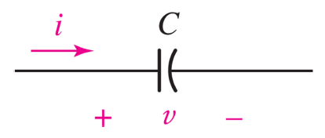
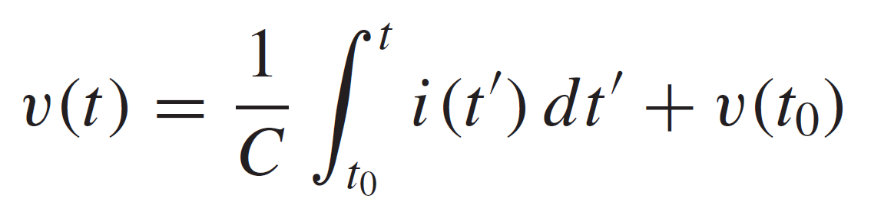
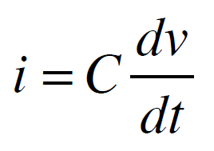
The Capacitor
the ideal capacitor is a passive element with circuit symbol
the current-voltage relation is
the capacitance C is measured in farads (F)

Slide 4
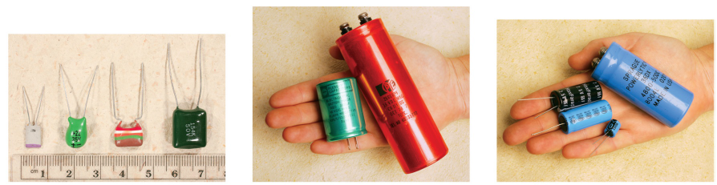
Some Capacitors
capacitors can be bulky and typical values range from pF to μF
Notes:
Electrolyte capacitors contain an (aluminium/tantalum) anode that is placed inside aluminium/tantalum oxide.
Ceramic capacitors use ceramic (e.g. barium titanate) as the dielectric.

Slide 5
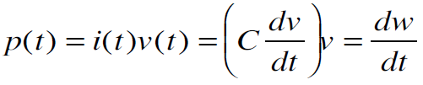
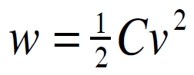
Capacitor Stores Energy
Since
then the energy stored in a capacitor is

Slide 6
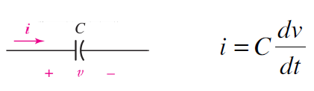
Key Capacitor Behaviors
capacitors are open circuits to dc voltages
the voltage on a capacitor cannot jump
capacitors store energy (iv>0) or deliver energy (iv<0)

Slide 7
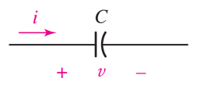
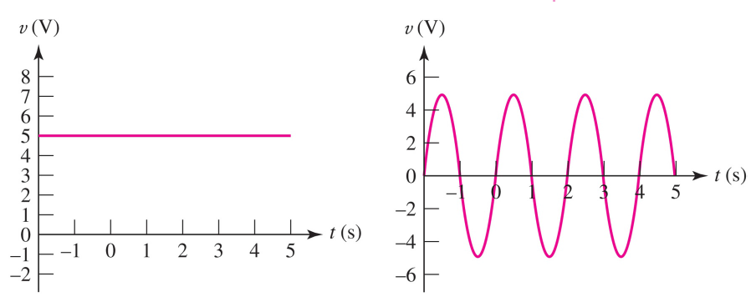
Example: i-v Curves (part 1 of 2)
Find i(t) for the voltages
shown, if C=2 F.

Slide 8
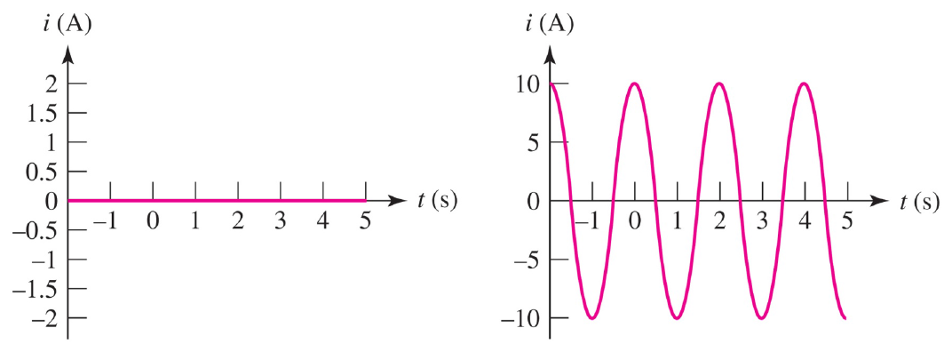
Example: i-v Curves (part 2 of 2)
Solution: apply i(t)=2dv/dt and graph:

Slide 9
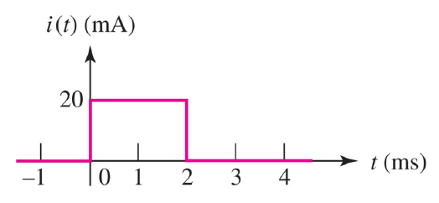
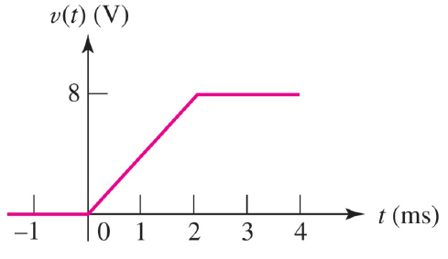
Example: i-v Curves
Find v(t) for a capacitor of C=5μF with given i(t):

Slide 10
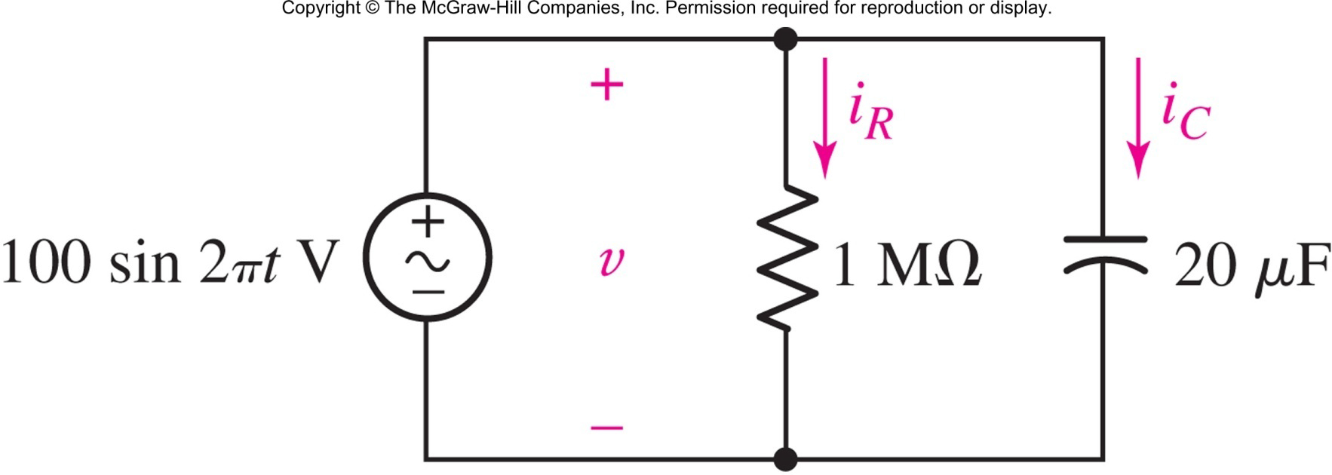
Example: Capacitor Energy
Determine the maximum energy stored in the capacitor, and plot i_{R} and i_{C} in the interval [0,0.5s]

Slide 11
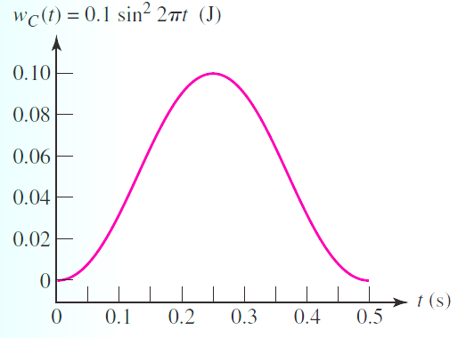
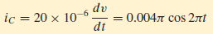
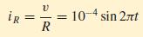
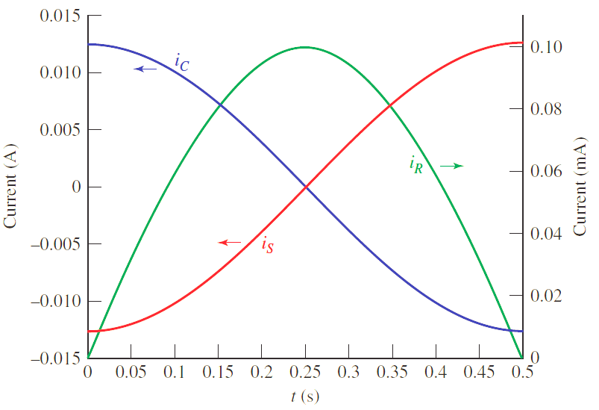
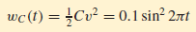
Solution

Slide 12
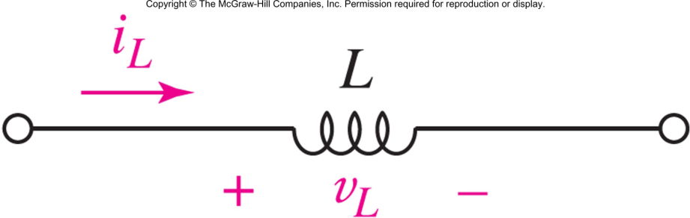
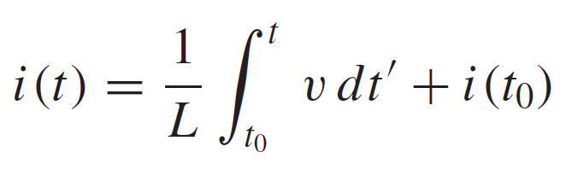
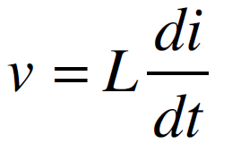
The Inductor
the ideal inductor is a passive element with circuit symbol
the current-voltage relation is
the unit of inductance L is henry (H)

Slide 13
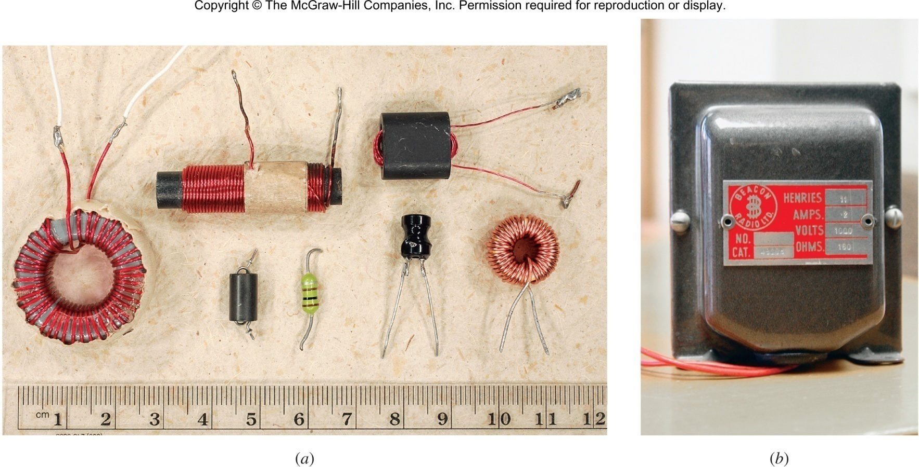
Some Inductors
inductors can be bulky and typical values range from μH to H

Slide 14
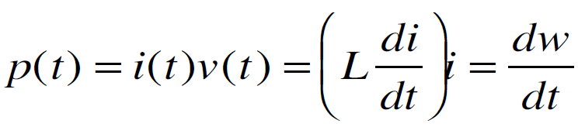
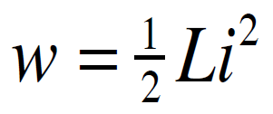
Inductor Stores Energy
Since
then the energy stored in a inductor is

Slide 15
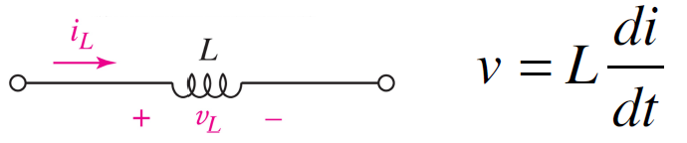
Key Inductor Behaviors
inductors are short circuits to dc voltages
the current through an inductor cannot jump
inductors store energy (iv>0) or deliver energy (iv<0)

Slide 16
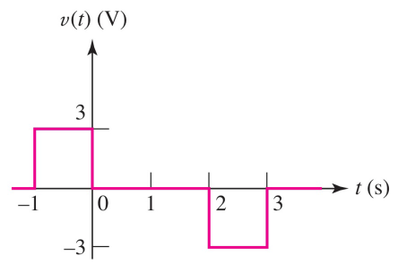
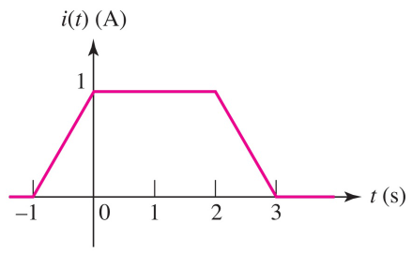
Example: i-v Curves for L
Find i(t) for an inductor of L=3 H with given v(t).

Slide 17
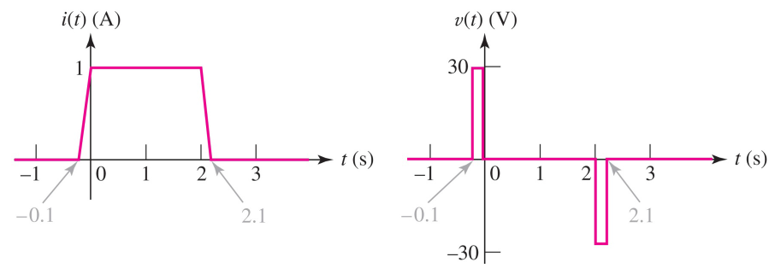
Example: i-v Curves for L
For the same 3-H inductor, the voltages are 10 times larger when the current is ramped 10 times faster

Slide 18
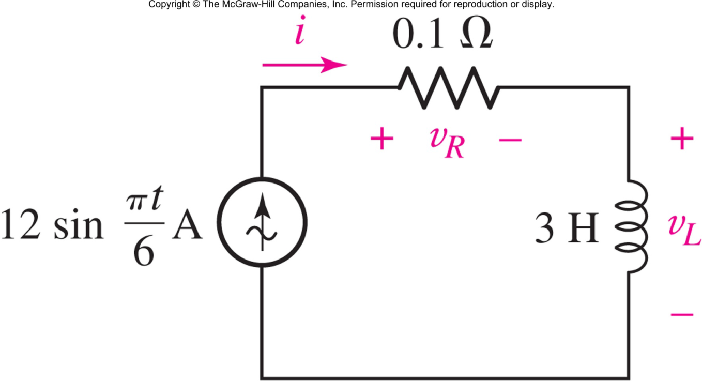
Example: Energy in L
Determine the maximum energy stored in the inductor, and find the energy lost to resistor from t=0 to t=6 s
Answer: 216 J, 43.2 J

Slide 19
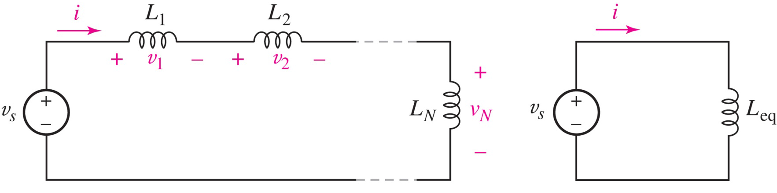
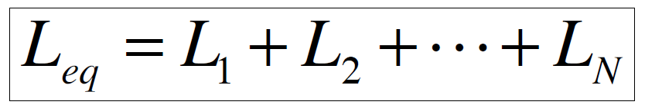
Inductors in Series
Apply KVL to show:

Slide 20
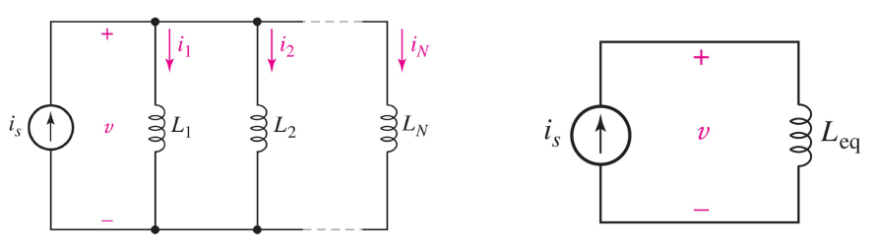
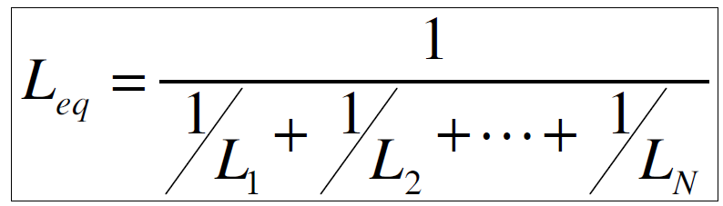
Inductors in Parallel
Apply KCL to show:

Slide 21
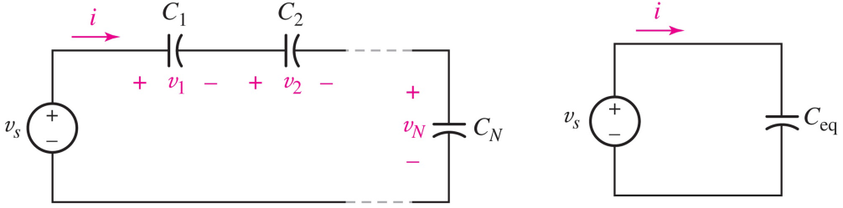
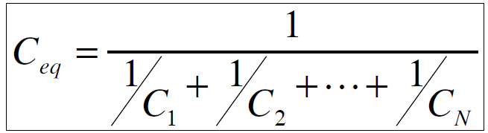
Capacitors in Series
Apply KVL to show:

Slide 22
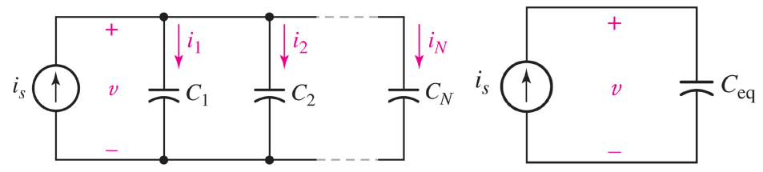
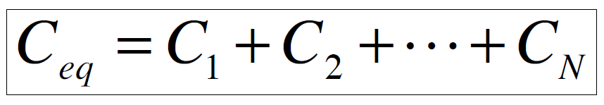
Capacitors in Parallel
Apply KCL to show:

Slide 23
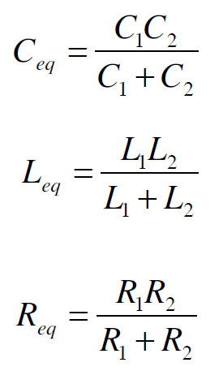
Two-Element Shortcuts
Two capacitors in series:
Two inductors in parallel:
Two resistors in parallel:

Slide 24
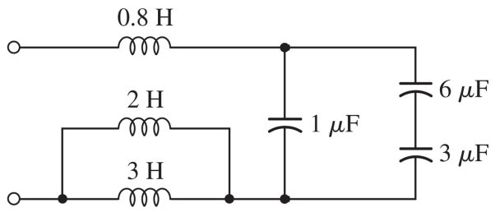
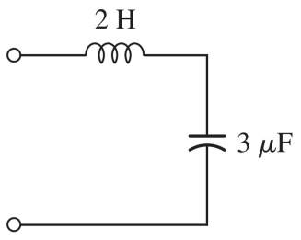
Example: Simplifying LC
Show that these circuits are
equivalent using series and
parallel combinations

Slide 25
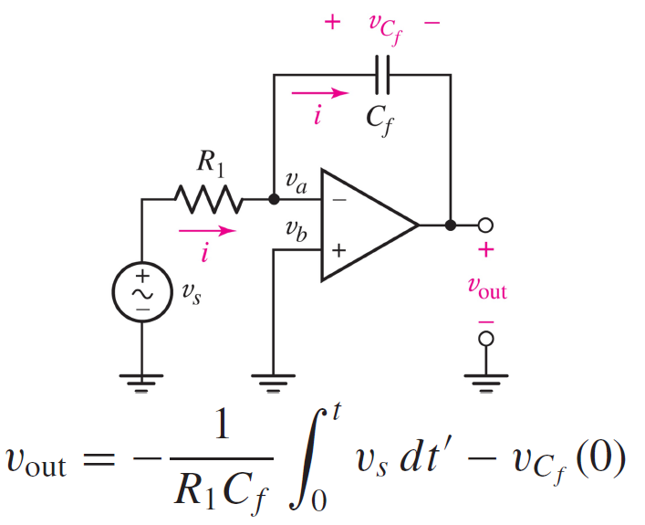
Op Amp Integrator

Slide 26
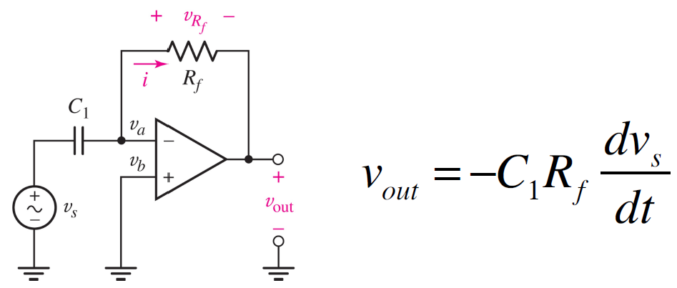
Op Amp Differentiator

Slide 27
Duality
Two circuits are duals if:
the mesh equations that characterize one of them have the same mathematical form as the nodal equations that characterize the other.
Duality
R | G
KVL | KCL
C | L
v(t) | i(t)
v_{s}(t) | i_{s}(t)
v_{C}(0) | i_{L}(0)

Slide 28
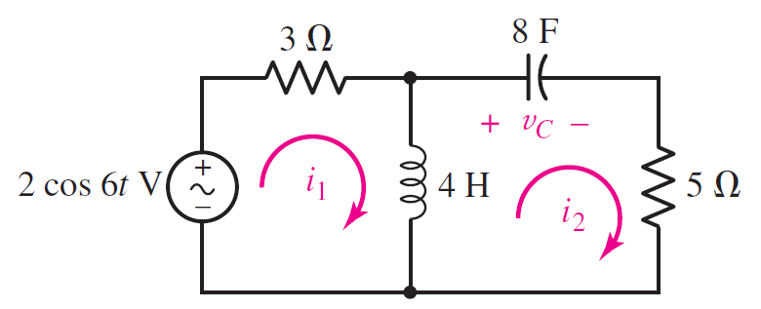
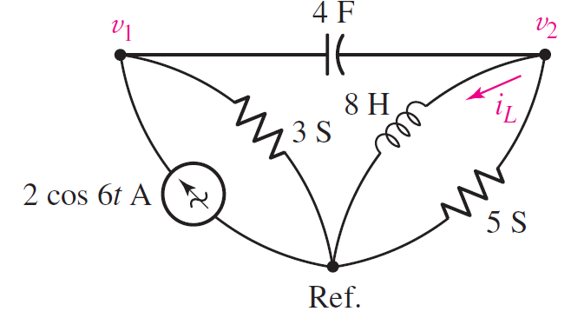
Example: Duality

Slide 29
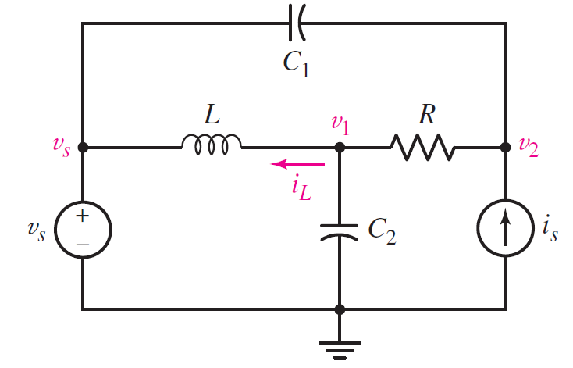
In-Class Exercise
Find v₁ and v₂ equations using nodal analysis

